Slide 1
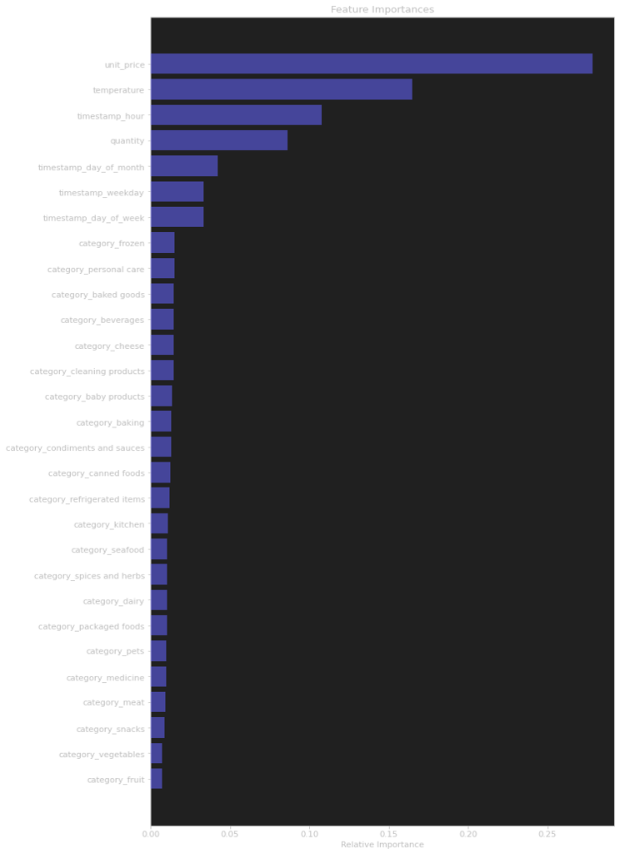
Data shortage
The current set of data and features produced approximately 45% accuracy; a larger data set is necessary to evaluate this model for production.
IOT
Temperature played a crucial role in the model, and we anticipate that its accuracy will rise when more IOT data are collected over a longer period of time. It also makes it possible to leverage publicly available data, like weather.

